Slide 1
Quad Band Inverted V maybe 15M too?
Designed by:
Ted McArthur AC7II
Presented by: Tyler Griffiths N7UWX
Made by: Tyler, Ted, Cordell

Slide 2
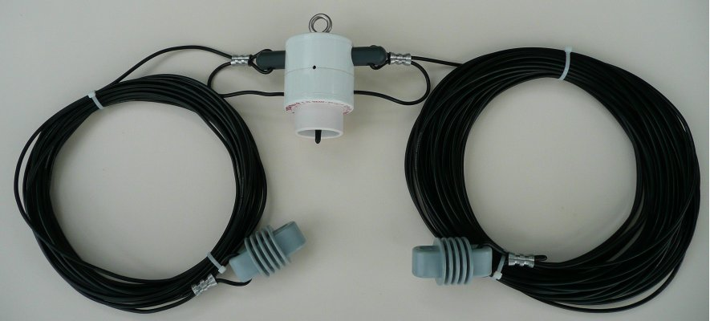
Spending the big bux?
4-Band 300 Watt OCF Dipole Antenna: $267 Special Price: $203!

Slide 3
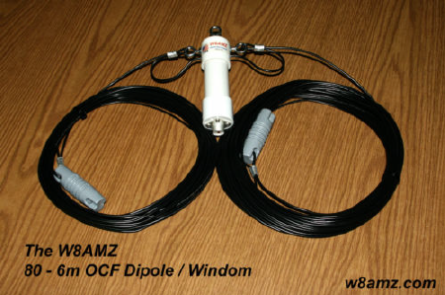
Spending the big bux?
OCF Dipole / Windom 6m - 80m $84.00

Slide 4
Ted’s Quad Band Dipole
Table of wire lengths
Band and Frequency | Inverted Vee | Dipole
10 Meters Freq. 28.4 MHz | 7.825’ Each leg | 8.24’ Each leg
20 Meters Freq. 14.3 MHz | 15.545’ Each leg | 16.365’ Each leg
40 Meters Freq. 7.25 MHz | 30.66’ Each leg | 32.275’ Each leg
80 Meters Freq. 3.85 MHz | 57.74’ Each leg | 60.78’ Each leg
The 40 Meter Antenna will also be resonate on 15 Meters.

Slide 5
Ted’s Quad Band Dipole
Price: Free (almost)

Slide 6
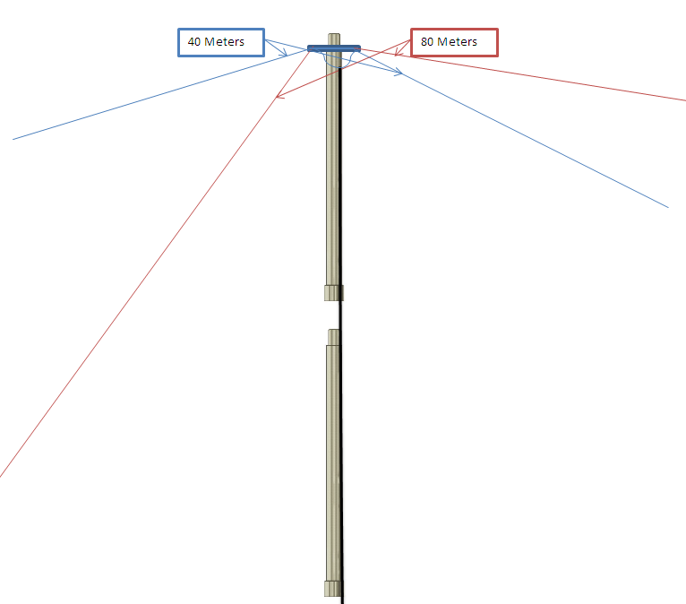
Ted’s Quad Band Dipole

Slide 7
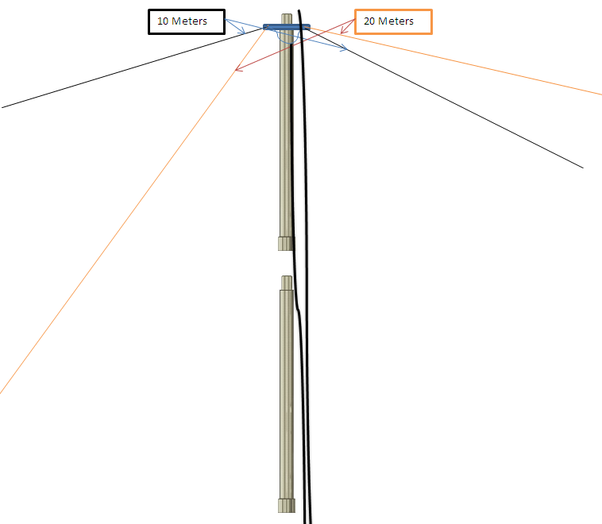
Ted’s Quad Band Dipole

Slide 8
Ted’s Quad Band Dipole
Items needed
250 feet 10 gauge wire (4 different colors if possible)
2 pieces of scrap Lexan
6 to 7 BARC tent poles
2 lengths of coax
Connectors
Solder and solder iron
Rubberized tape
Bailing twine

Slide 9
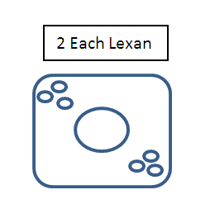
Ted’s Quad Band Dipole

Slide 15
Ted’s Quad Band Dipole
Table of wire lengths
Band and Frequency | Inverted Vee | Dipole
10 Meters Freq. 28.4 MHz | 7.825’ Each leg | 8.24’ Each leg
20 Meters Freq. 14.3 MHz | 15.545’ Each leg | 16.365’ Each leg
40 Meters Freq. 7.25 MHz | 30.66’ Each leg | 32.275’ Each leg
80 Meters Freq. 3.85 MHz | 57.74’ Each leg | 60.78’ Each leg
The 40 Meter Antenna will also be resonate on 15 Meters.

Slide 21
10m

Slide 22
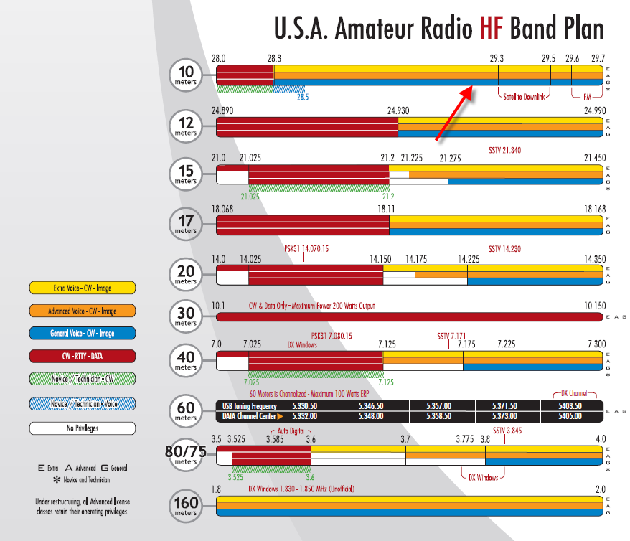

Slide 23
20m

Slide 24
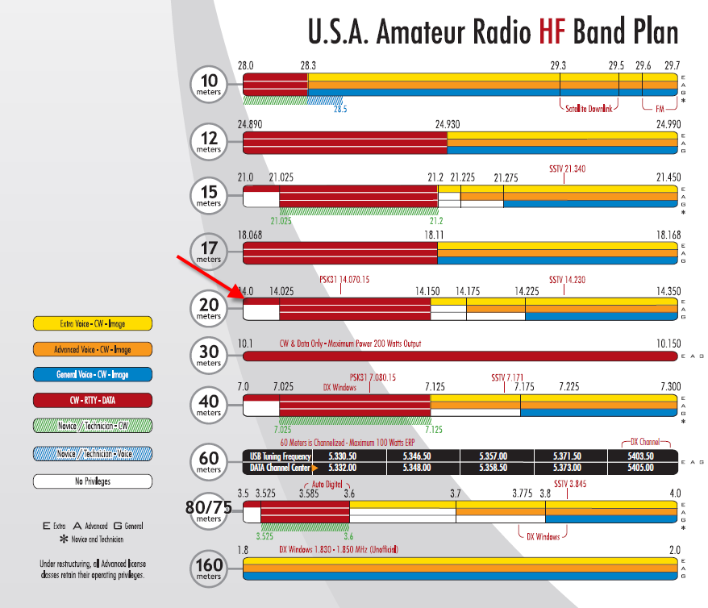

Slide 25
40m

Slide 26
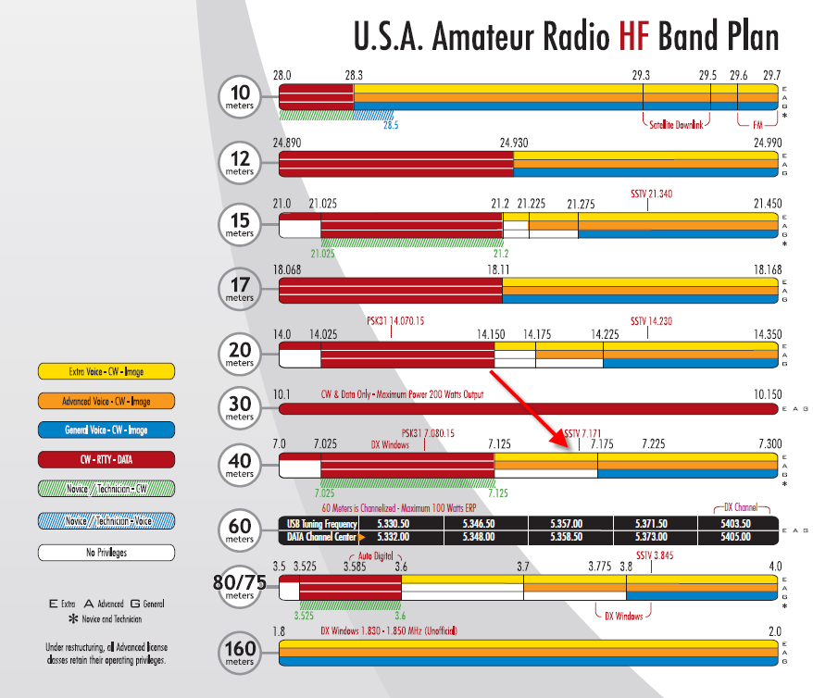

Slide 27
80m

Slide 28
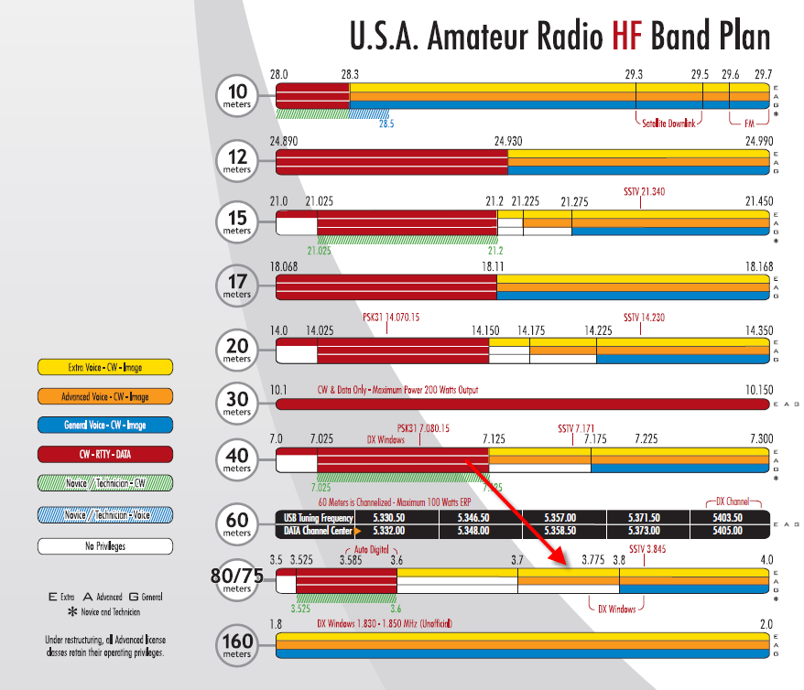

Slide 29
Ted’s Quad Band Dipole
Angle of elements should be 60 to 120 Degrees.
Attach twine to end of wires then use them to also be the guy wires to hold the mast vertical.
You may stake the upper and lower levels to the same points. It is best to leave the wires a little long then test the freq. and trim to desired Resonate freq.
At each level attach a coax connect one of each wire length to center conductor then the other two need to be attached to the Shield of the Coax.
You can experiment with the amount of Poles at the bottom and between levels.

Slide 30
Questions?

