Slide 1
Dipole Antenna
Building and installing

Slide 2
Content
INTRODUCTION
WORKING
PARAMETERS
ADVANTAGES
DISADVANTAGES
BUILDING
INSTALLING

Slide 3
INTRODUCTION
Antenna is an electrical device which converts electric power into electromagnetic waves and vice versa.
Half wave dipole antenna consists of two identical conductive elements such as metal rods which are bilaterally symmetrical.
The "half-wave" term means that the length of this dipole antenna is equal to a half-wavelength at the frequency of operation.

Slide 4
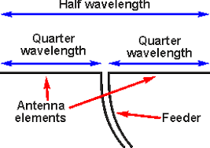
WORKING
It is basically fed in the center where the impedance falls to lowest.
The voltage and current levels vary along the length of the radiating section of the antenna.
For a dipole antenna that is an electrical half wavelength long, the inductive and capacitive reactance cancel each other and the antenna becomes resonant.

Slide 5
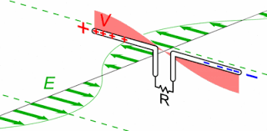
Working (continued)
A half-wave dipole antenna receiving power from a radio wave. The electric field of the wave (E, green arrows) pushes the electrons in the antenna elements back and forth (black arrows), charging the ends of the antenna alternately positive and negative. Since the antenna is a half-wavelength long at the radio wave's frequency, it excites standing waves of voltage (V, red) and current in the antenna. These oscillating currents flow down the transmission line into the radio receiver (represented by the resistor R). The action is shown slowed down in this animation.

Slide 6
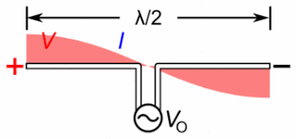
Working (continued)
The sinusoidal standing waves of voltage(V, red) and current (I, blue) on a half-wave dipole driven by an AC voltage at its resonant frequency.

Slide 7
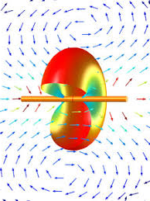
parameters
Radiation pattern
Its radiation pattern in three dimensions is shaped like a toroid (doughnut) symmetric about the axis of the dipole.
Directivity ≈ 2.1dB.
SWR bandwidth ≈ 5% of designed frequency.
Polarization is both vertical and horizontal.
Self impedance is (40-80)Ω with no reactive components.

Slide 8
advantages
It receives balanced signals.
The two pole design enables to receive signals from a variety of frequencies.
Most of the radiating signal is transmitted closer to the horizon so, loss is less.
It does not require an antenna “tuner” to work efficiently.

Slide 9
disadvantages
The outdoors antennas are large and wide.
This type of antenna is not used for space communication.
The installation of outdoors antenna are difficult.

Slide 10
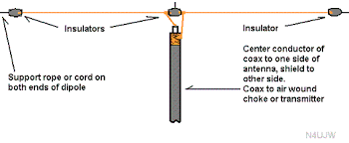
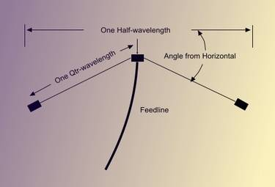
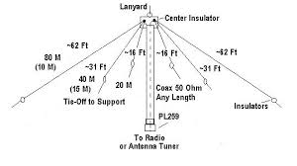
Configuration
Normal Dipole
Inverted Vee
Multiple Band

Slide 11
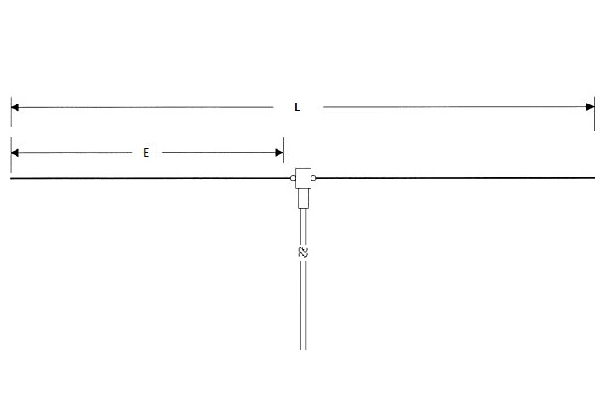
Calculating the Length Dipole
Formula:
L=468/f
E=L/2

Slide 12
Calculating the Length Inverted Vee
Calculator

Slide 13
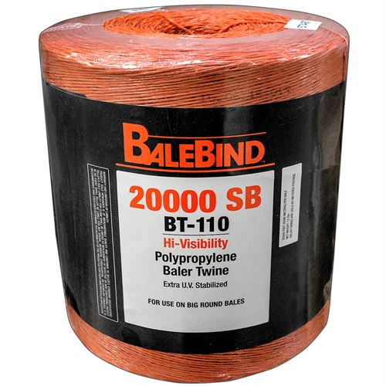
Guy Ropes For Wire Antennas
For temporary installs like Field Day you can use Bailing Twine. This will only last a year or so in the sun light,
A permeant install you will need a UV resistant rope like Synthetic Textile Industries Dacron Rope sold by most Ham Radio Dealers.

Slide 14
Ways Barc has installed them for field day
Crescent Wrench
Sling Shot
Bow and Arrow
Potato Launcher
Drone? maybe in the future
Field Day 2012

Slide 15
Hanging a Treetop Antenna with a Drone
March 2018 QST

Slide 16
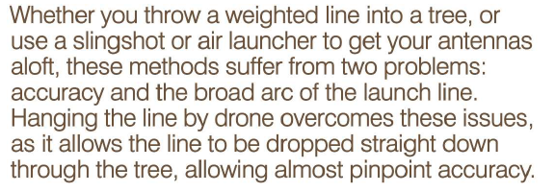

Slide 17
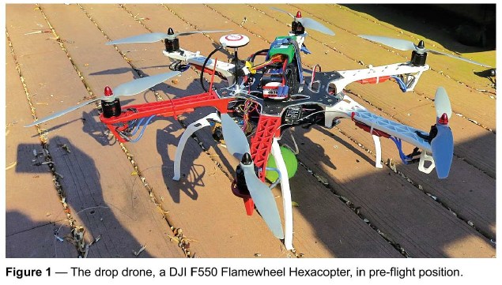

Slide 18
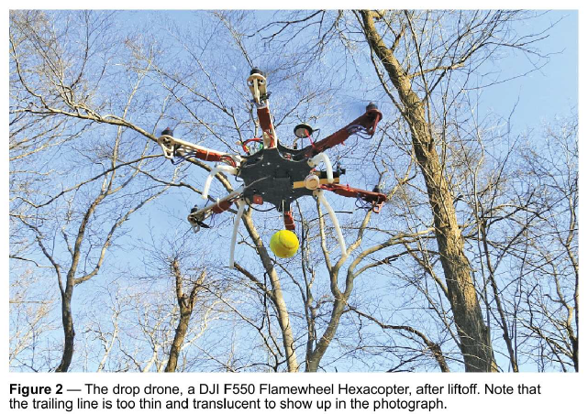

Slide 19
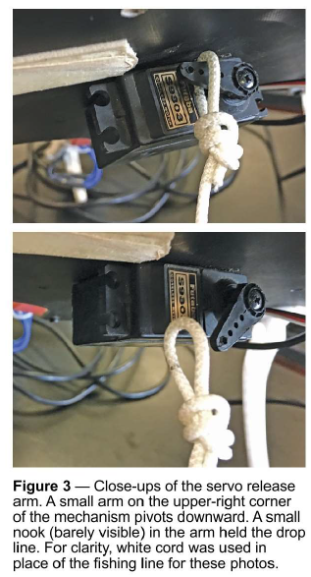

Slide 20
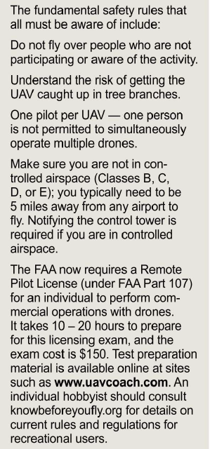

Slide 21
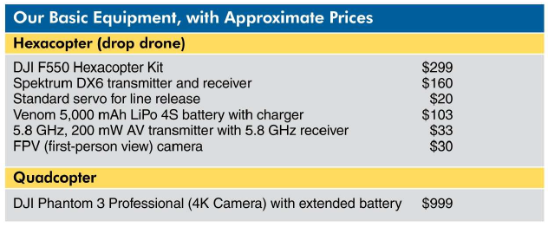

Slide 22
