Slide 1
Remote Shack Remote Control
TYLER - N7UWX

Slide 2
Team Viewer (Free)
Available for
PC
And
Smart Phone
www.teamviewer.com

Slide 3
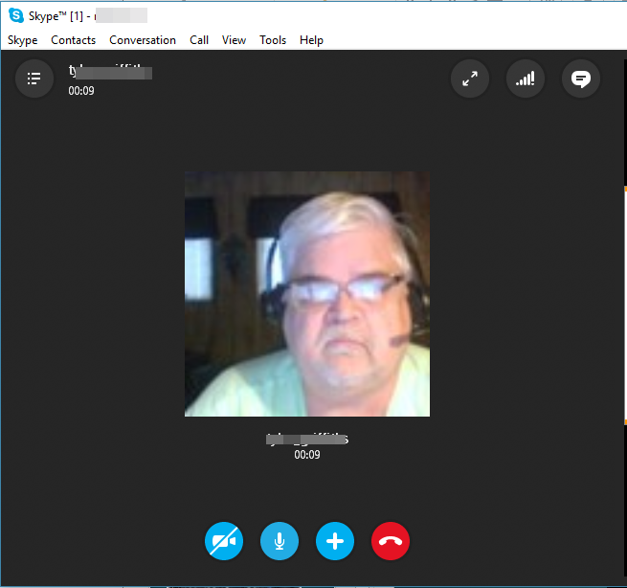
Skype - PC

Slide 4
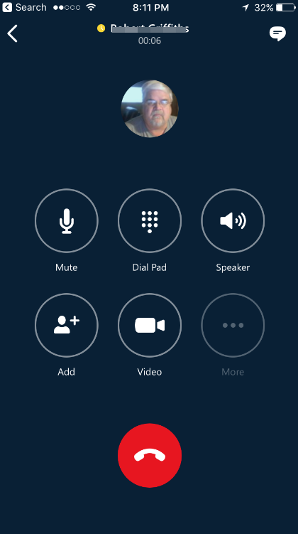
Skype – Smart Phone

Slide 5
Kenwood TS200 Software (ARCP-2000)

Slide 6
KENWOOD TS-2000

Slide 7
SignaLInk USB
www.tigertronics.com

Slide 8
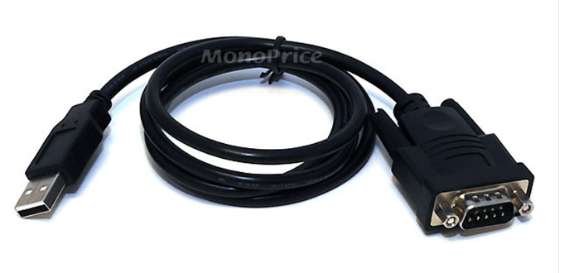
2 Available UDB Ports

Slide 10
Kenwood Sky Command System II+
Sky Command can be ran from
TS-2000
TS-590S*
TH-D7A
TM-700
TM-D710A
TM-D710AG
TH-D74A*

